Slide 1


Confidential
Program, Project and Change Management Toolkit
Overview and Approach

Slide 2
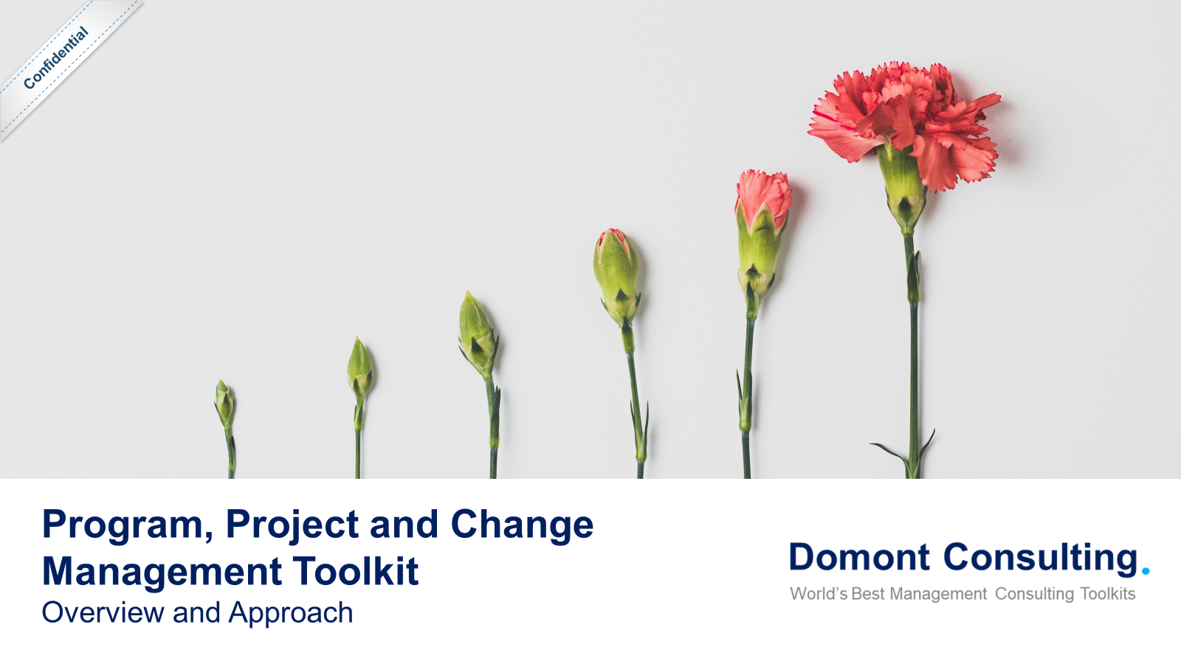
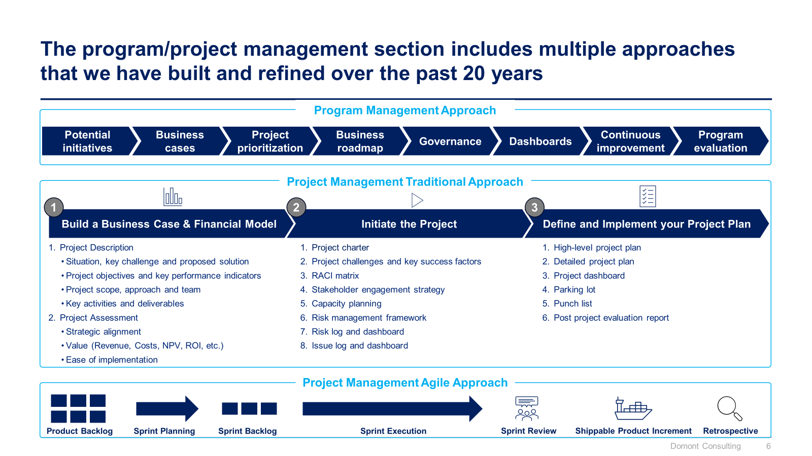
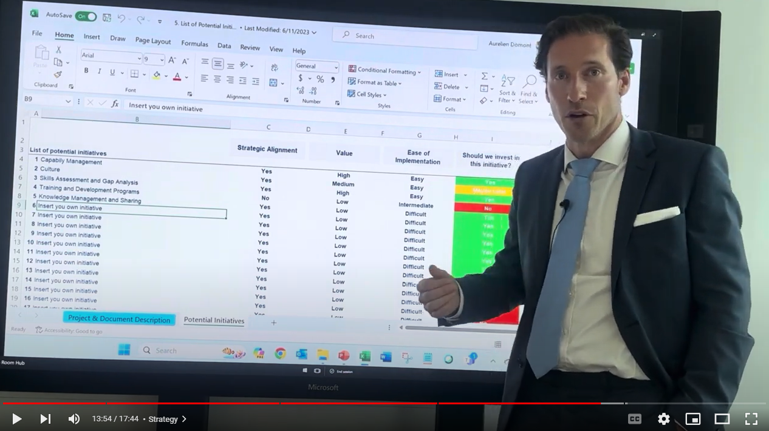
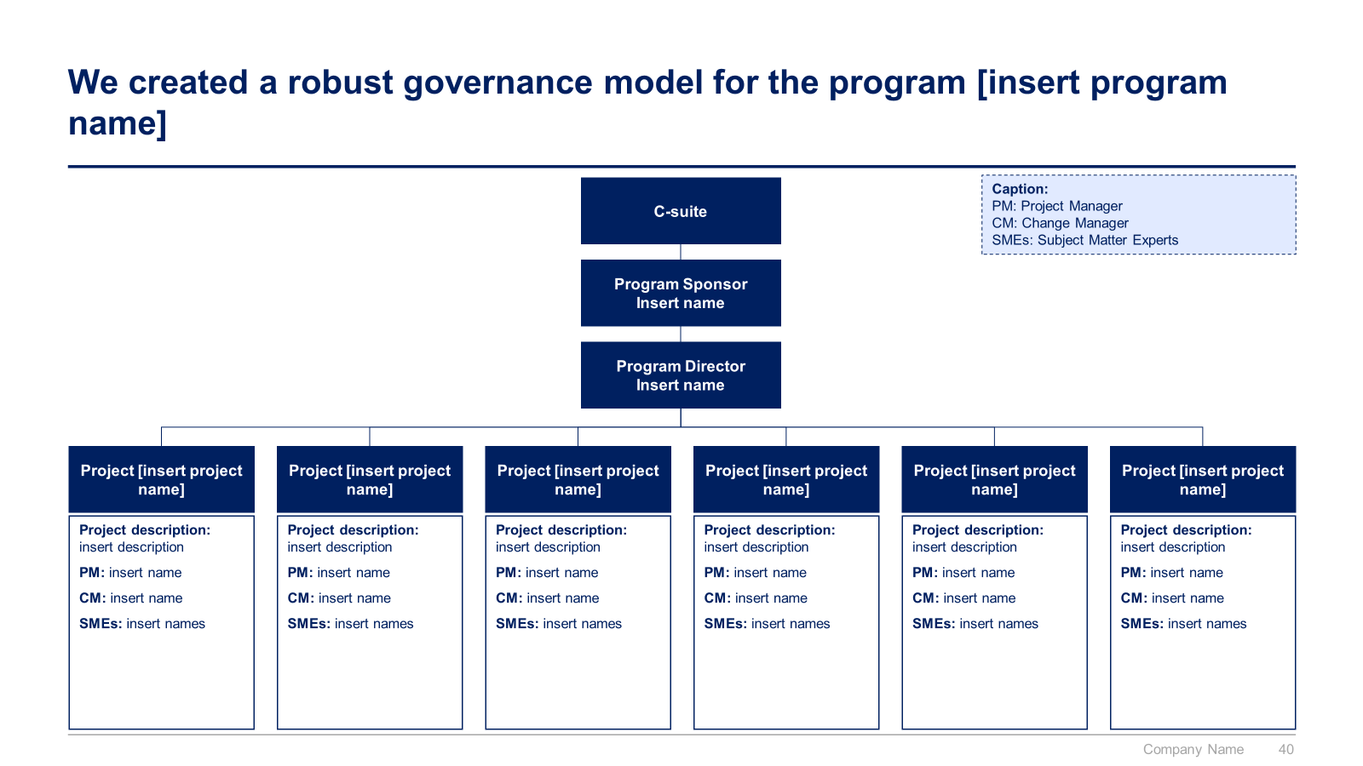
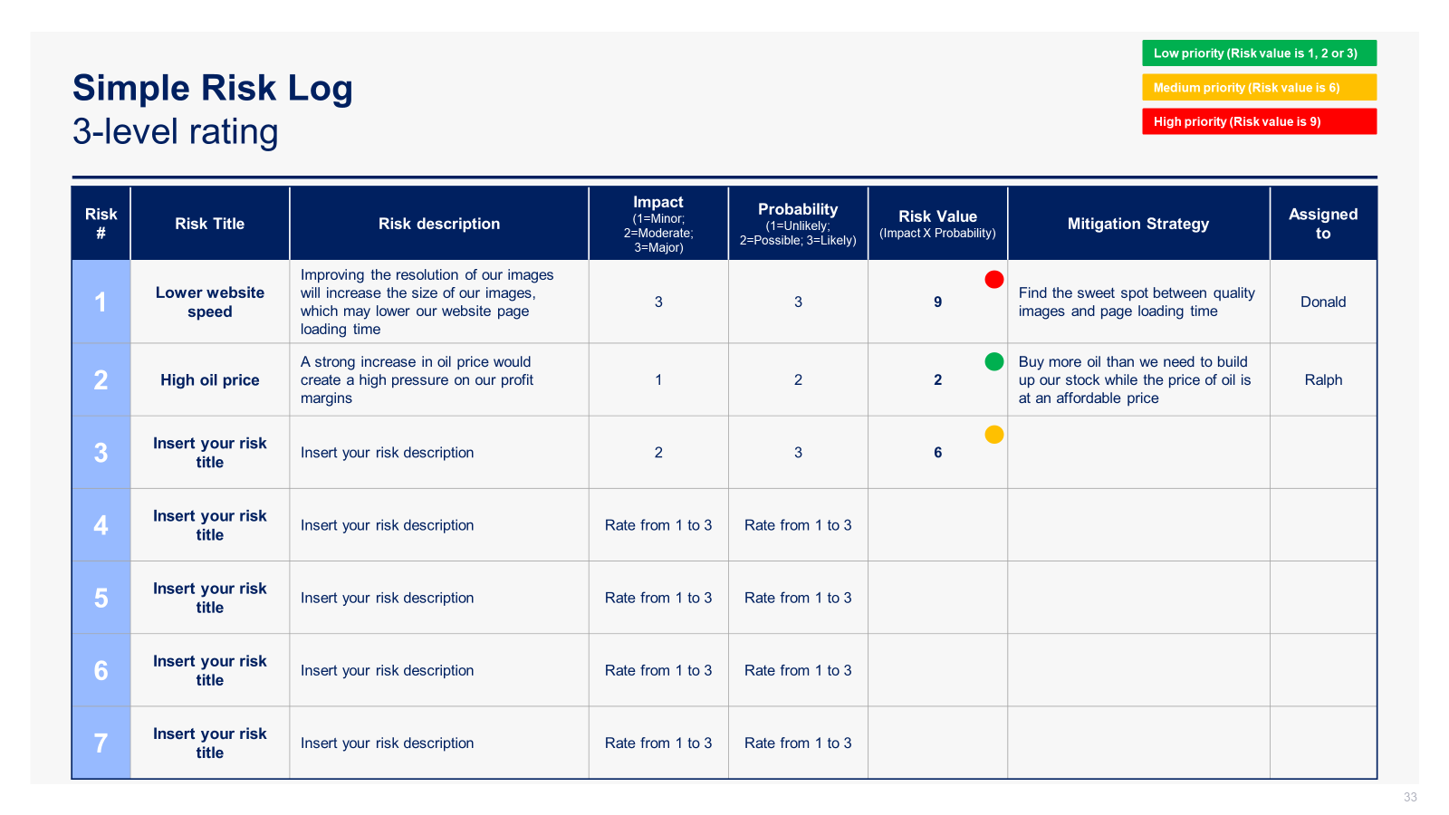
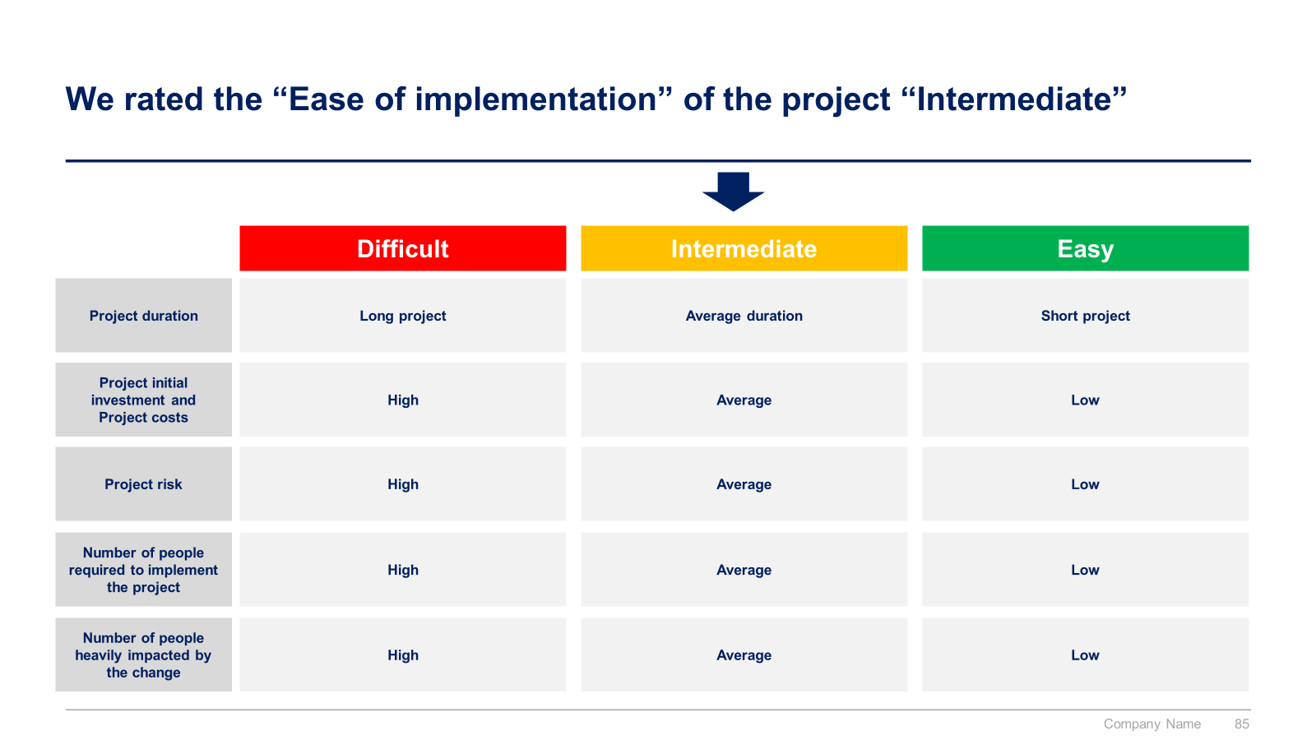
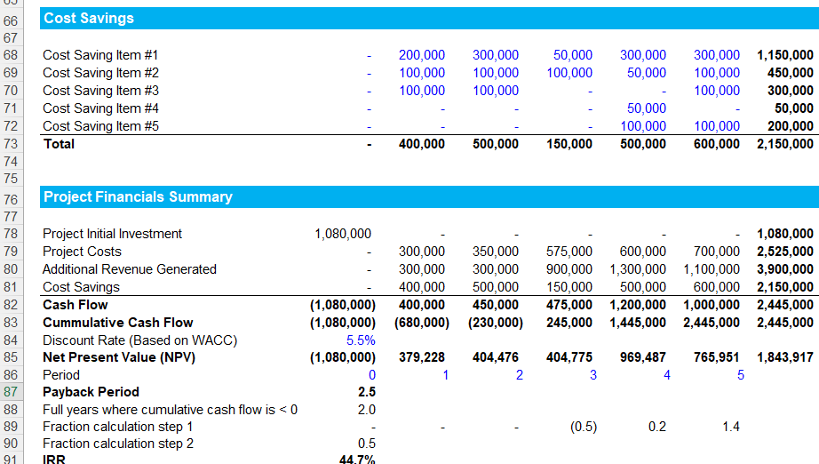
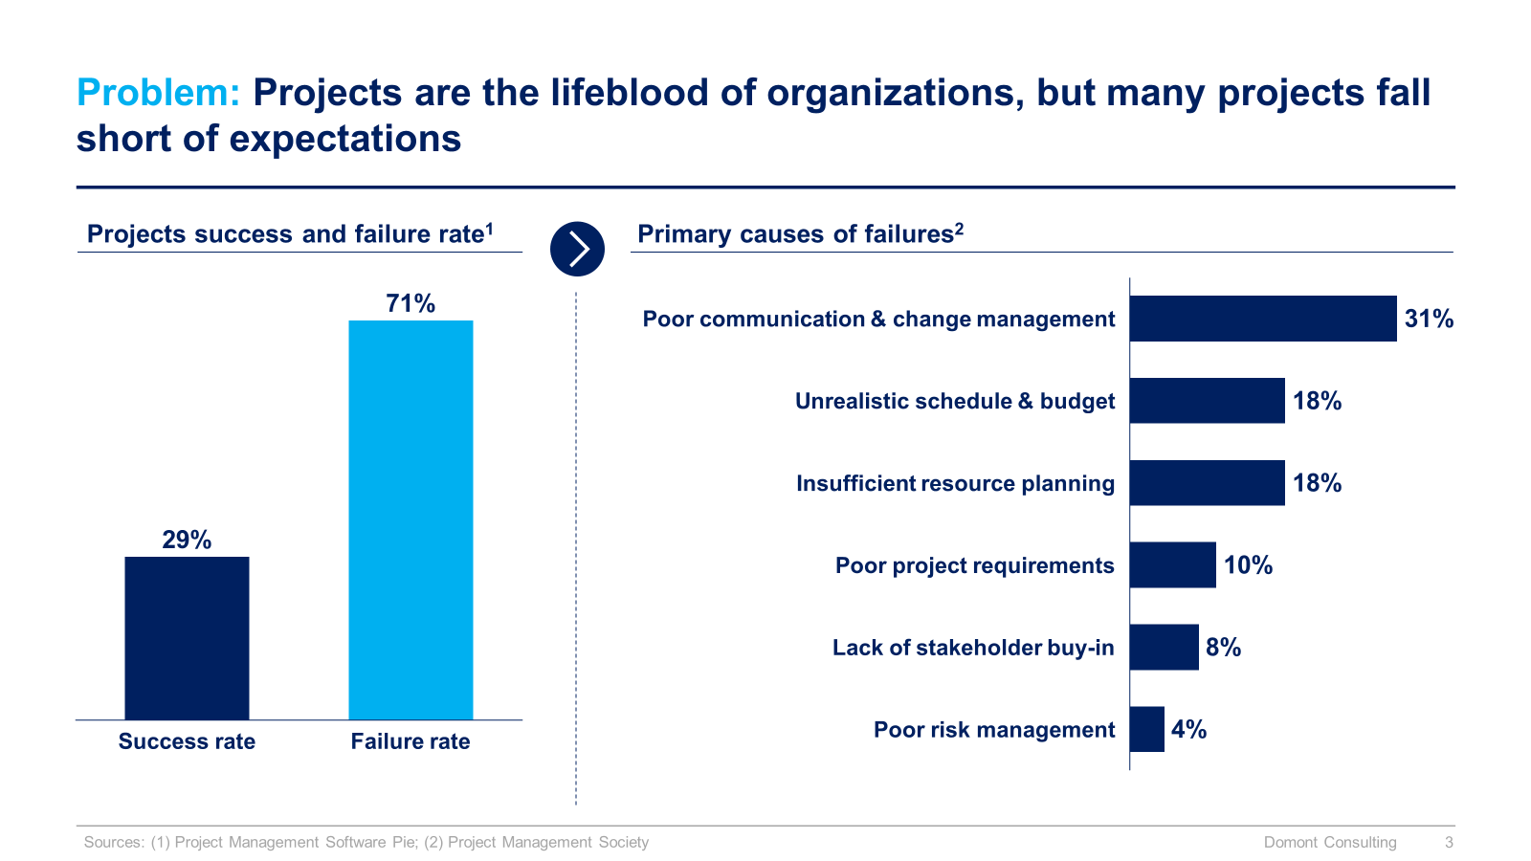
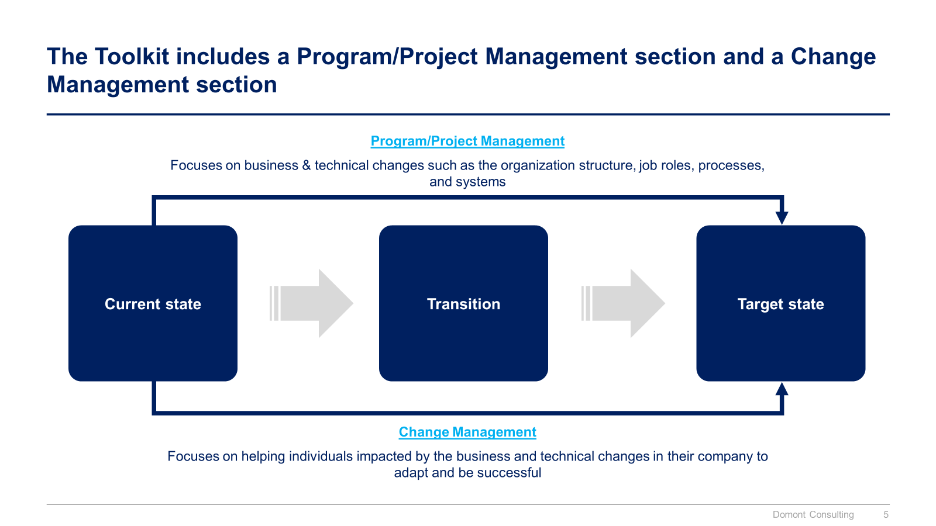

Slide 3


Introduction
This Toolkit was created after 4,000+ hours of work by ex-McKinsey, Deloitte & BCG Consultants. It is considered the world's best & most comprehensive Program, Project and Change Management Toolkit. It includes all the Frameworks, Tools & Templates required to improve the Capability of your organization & excel as a Program Director, Project Manager or Change Manager.
Join the 200,000+ Executives, Consultants & Entrepreneurs who are already leveraging our Management Consulting Toolkits to improve the performance of their organization and boost their own career.
If you have any questions, send us an email at support@domontconsulting.com and one of our ex-McKinsey, Deloitte & BCG Management Consultants will get back to you within 2 business days.
Aurelien Domont
Management Consultant
Domont Consulting Managing Director

Slide 4

Problem: Projects are the lifeblood of organizations, but many projects fall short of expectations
Projects success and failure rate¹
Primary causes of failures²
Poor communication & change management
Unrealistic schedule & budget
Insufficient resource planning
Poor project requirements
Lack of stakeholder buy-in
Success rate
Failure rate
Poor risk management
Sources: (1) Project Management Software Pie; (2) Project Management Society

Slide 5












Solution: Our ex-McKinsey, Deloitte & BCG consultants created a Toolkit to help you significantly increase your projects success rate
What’s inside the Toolkit?
Who created the Toolkit?
The Toolkit was created by former McKinsey, Deloitte & BCG management consultants.
Best Practices
Frameworks
Number of professionals leveraging our Toolkits
Advice from
tier-1 Management Consultants
Tools
There are 200,000+ Executives, Consultants & Entrepreneurs leveraging our Toolkits to improve the performance of their organization.
Real-life Examples
Templates
Trusted by small and large organizations
Video Training
Step-by-step Tutorials

Slide 6
The Toolkit includes a Program/Project Management section and a Change Management section
Program/Project Management
Focuses on business & technical changes such as the organization structure, job roles, processes, and systems
Current state
Transition
Target state
Change Management
Focuses on helping individuals impacted by the business and technical changes in their company to adapt and be successful

Slide 7






The program/project management section includes multiple approaches that we have built and refined over the past 20 years
Program Management Approach
Potential initiatives
Business cases
Project prioritization
Business roadmap
Governance
Dashboards
Continuous improvement
Program evaluation
Project Management Traditional Approach
1
2
3
Build a Business Case & Financial Model
Initiate the Project
Define and Implement your Project Plan
Project Description
Situation, key challenge and proposed solution
Project objectives and key performance indicators
Project scope, approach and team
Key activities and deliverables
Project Assessment
Strategic alignment
Value (Revenue, Costs, NPV, ROI, etc.)
Ease of implementation
Project charter
Project challenges and key success factors
RACI matrix
Stakeholder engagement strategy
Capacity planning
Risk management framework
Risk log and dashboard
Issue log and dashboard
High-level project plan
Detailed project plan
Project dashboard
Parking lot
Punch list
Project closure checklist
Post project evaluation report
Project Management Agile Approach
Product Backlog
Sprint Planning
Sprint Backlog
Sprint Execution
Sprint Review
Shippable Product Increment
Retrospective

Slide 8
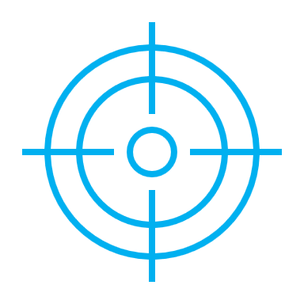

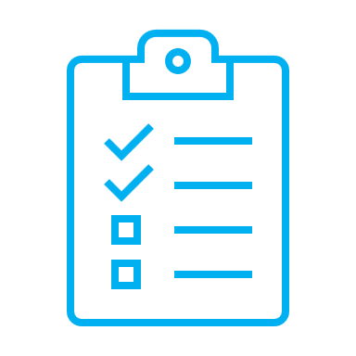
The change management section includes a practical 3-phase approach and tier-1 frameworks and tools used by Fortune 100 companies
1
2
3
Define the Change Management Strategy
Develop the Change Management Plans
Implement, Track and Manage Progress
Company strategy
Enterprise change management maturity levels
Required change to implement the strategy
Business roadmap
Company readiness for change
Structure and size of the change management team
Roles & responsibilities
Guiding principles
Change Lean Canvas
Change impact assessment
Change management objectives and levers (ADKAR Model)
Overarching change management plan
Communication plan
Sponsorship plan
Coaching plan
Training plan
Resistance management plan
Governance
Overarching change management plan status report
Communication plan status report
Sponsorship plan status report
Coaching plan status report
Training plan status report
Resistance management plan status report
Stakeholder management
Change sustainment
Project closure checklist
Top 12 change management frameworks and tools commonly used in most Fortune 100 companies
Kotter’s 8 step Model of Change
McKinsey 7S framework
Burke-Litwin Change Model
Prosci 3-phase process
The Adkar Change Management Model
Lewin's Change Management Model
Change commitment curve
Change personal transition curve
Heart and mind human drivers
Innovation adoption curve
Maslow’s hierarchy of human needs
Four stages of team development

Slide 9
Our Toolkit will help you fulfill multiple objectives
The Program, Project and Change Management Toolkit includes frameworks, tools, templates, tutorials, real-life examples, video training, and best practices to help you:
Program/Project Management
Adopt a robust program management approach: (1) Potential initiatives, (2) Business cases, (3) Project prioritization, (4) Business roadmap, (5) Governance, (6) Dashboards, (7) Continuous improvement, (8) Program evaluation
Improve the project management capabilities of your organization with a simple and comprehensive 3-phase approach: (I) Build a business case and financial model, (II) Initiate the project, (III) Define and implement your project plan
(I) Build a business case and financial model to get your project approved by the executive committee: (1) Situation, key challenge and proposed solution, (2) Project objectives and key performance indicators (KPIs), (3) Project scope, approach and team, (4) Key activities and deliverables, (5) Strategic alignment, (6) Value: project initial investment, project costs, additional revenue generated, cost savings, cash flows and net present value, (7) Ease of implementation
(II) Initiate your project: (1) Project charter, (2) Project challenges and key success factors, (3) RACI matrix, (4) Stakeholder analysis, (5) Capacity planning, (6) Risk management framework, (7) Risk log and dashboard, (8) Issue log and dashboard
(III) Define and implement your project plan: (1) High-level project plan, (2) Detailed project plan, (3) Project dashboard, (4) Parking lot, (5) Punch list, (6) Project closure checklist, (7) Post-project evaluation report
Become a more agile organization with a 7-phase approach commonly used by Fortune 500 and global consulting firms: (1) Product Backlog, (2) Sprint Planning, (3) Sprint Backlog, (4) Sprint Execution, (5) Sprint Review, (6) Potentially Shippable Product Increment, (7) Retrospective
Change Management
Improve the change management capabilities of your organization with a simple and comprehensive 3-phase approach: (I) Define the change management strategy, (II) Develop the Change Management Plans, (III) Implement, Track and Manage Progress
(I) Define your change management strategy: (1) Company strategy, (2) Required change to implement the strategy, (3) Business roadmap, (4) Company readiness for change, (5) Structure and size of the change management team, (6) Roles and responsibilities, (7) Guiding principles, (8) Lean change canvas, (9) Change impact assessment, (10) Change management objectives and levers (ADKAR Model)
(II) Develop your change management plans: (1) Overarching change management plan, (2) Communication plan, (3) Sponsorship plan, (4) Coaching plan, (5) Training plan, (6) Resistance management plan
(III) Implement, track and manage progress: (1) Governance, (2) Overarching change management plan status report, (3) Communication plan status report, (4) Sponsorship plan status report, (5) Coaching plan status report, (6) Training plan status report, (7) Resistance management plan status report, (8) Change sustainment, (9) Project closure checklist
Leverage the top 12 change management frameworks and tools: (1) Kotter’s 8 step Model of Change, (2) McKinsey 7S framework, (3) Burke-Litwin Change Model, (4) Prosci 3-phase process, (5) The Adkar Change Management Model, (6) Lewin's Change Management Model, (7) Change commitment curve, (8) Change personal transition curve, (9) Heart and mind human drivers, (10) Innovation adoption curve, (11) Maslow’s hierarchy of human needs, (12) Four stages of team development

Slide 10
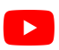
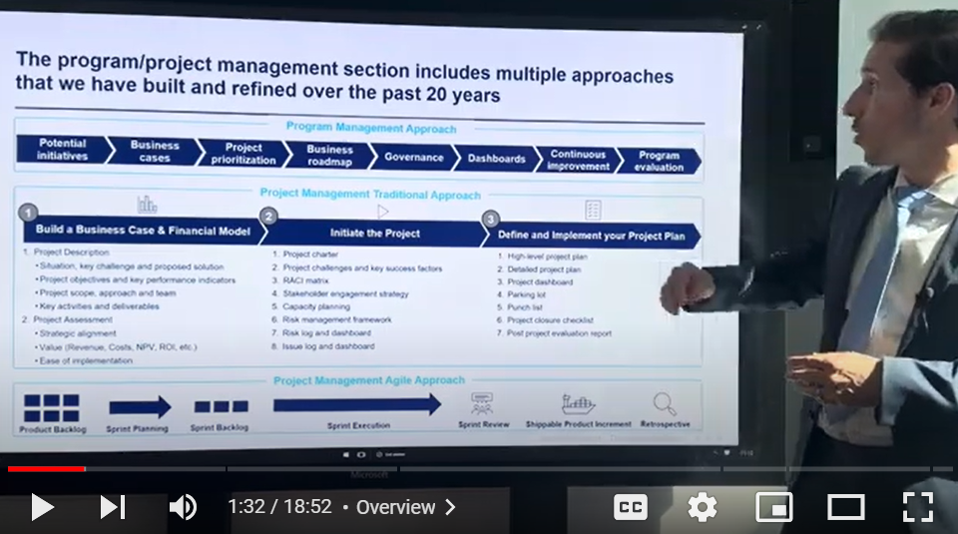
Video demonstration of the Program, Project and Change Management Toolkit
Video Demo Access
Video Demo Visual
Select “Slide Show” mode and then click on the link below or on the image on the right to access this video demo.
You can also access the video by copy pasting the following URL in your browser:
https://youtu.be/r3YiLW1Ioqg

Slide 11
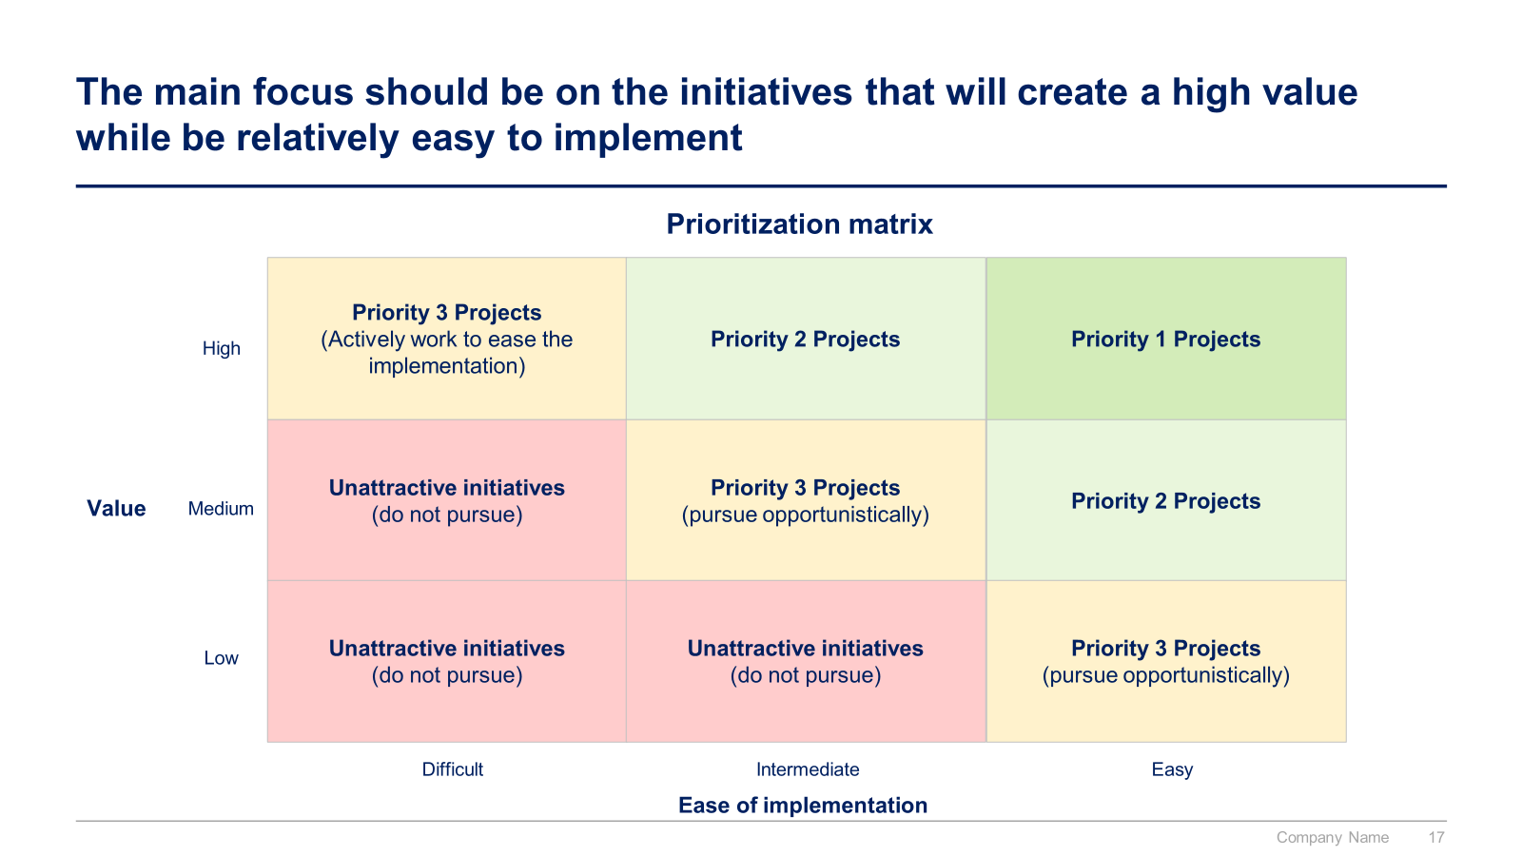
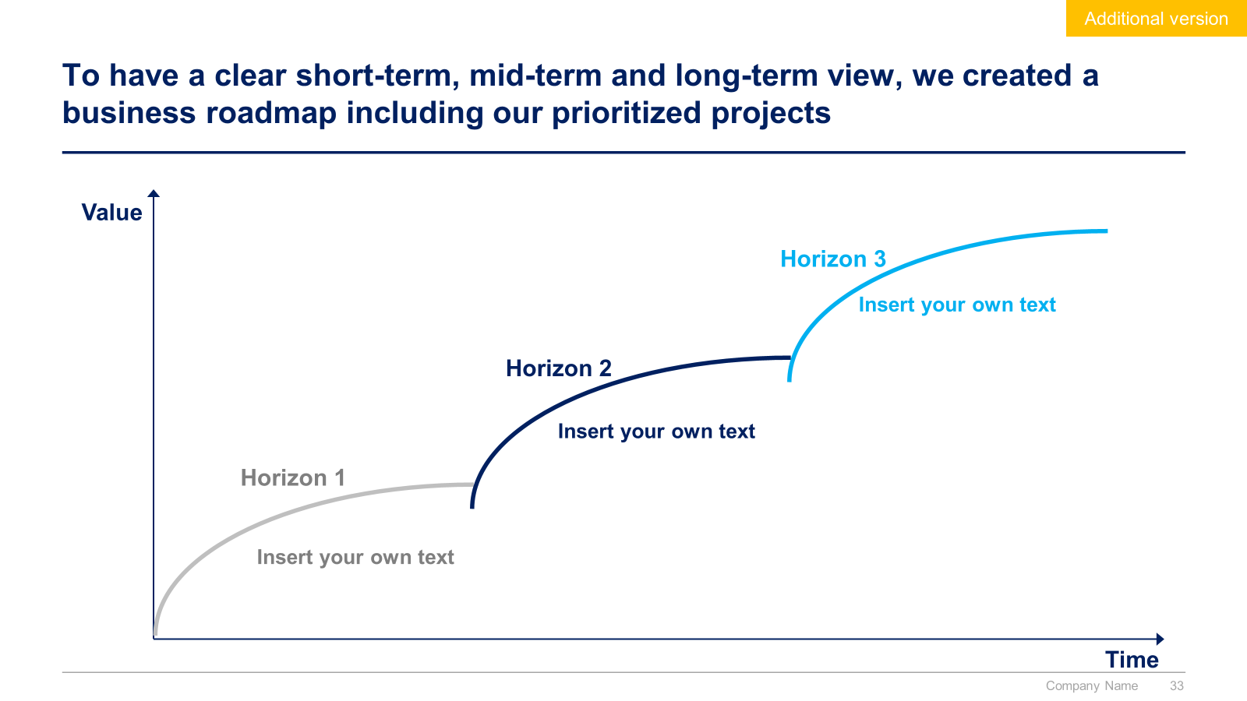
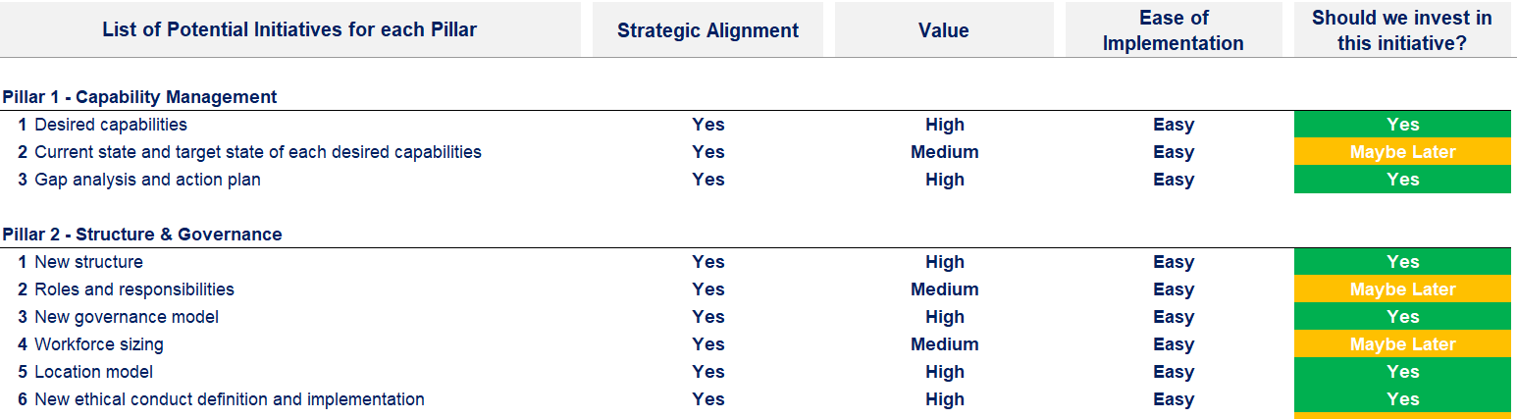
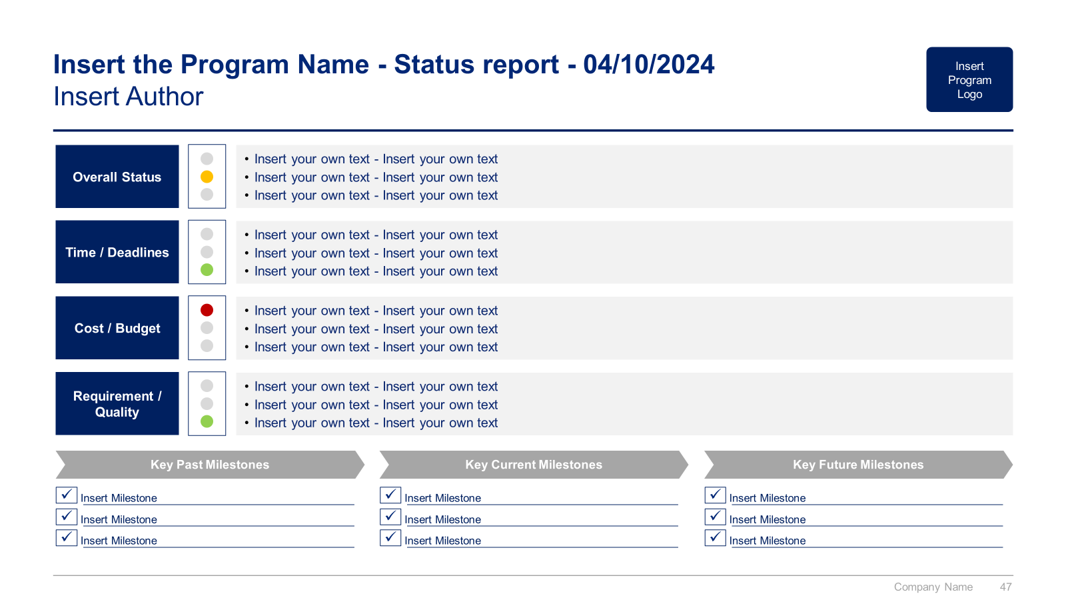
Small preview of the program management approach

Slide 12
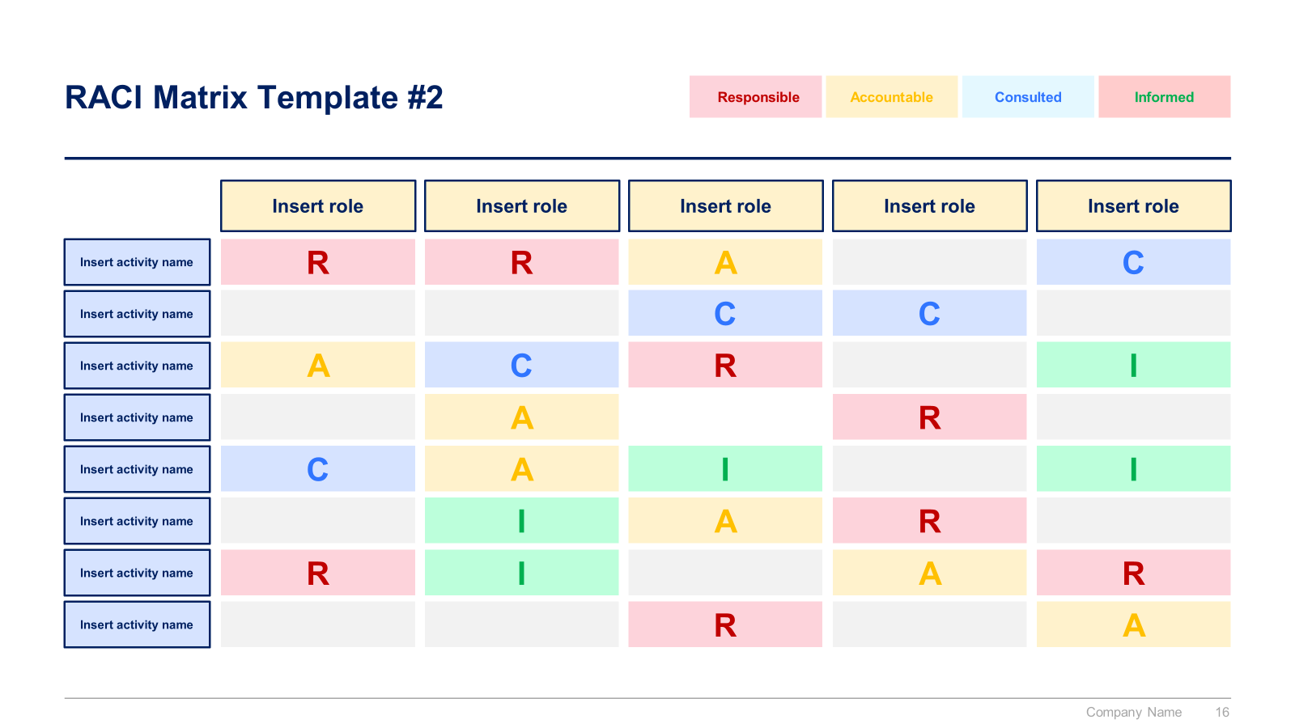
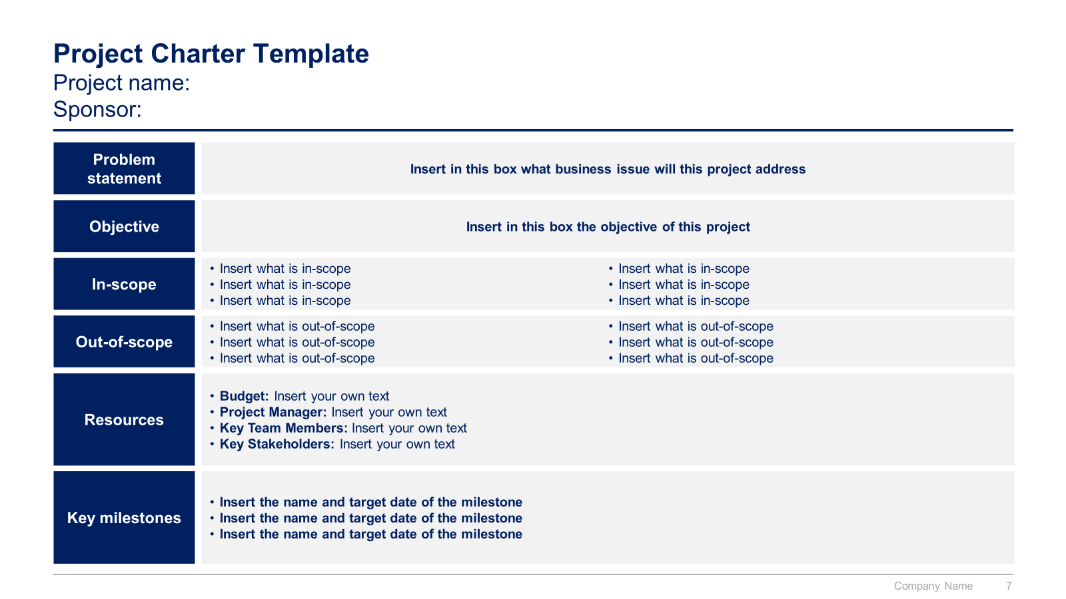
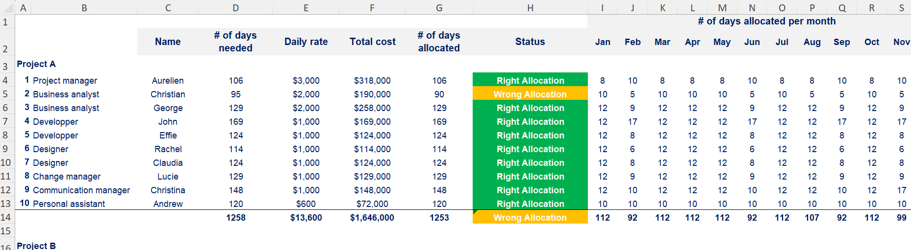
Small preview of the project management traditional approach (1/2)

Slide 13
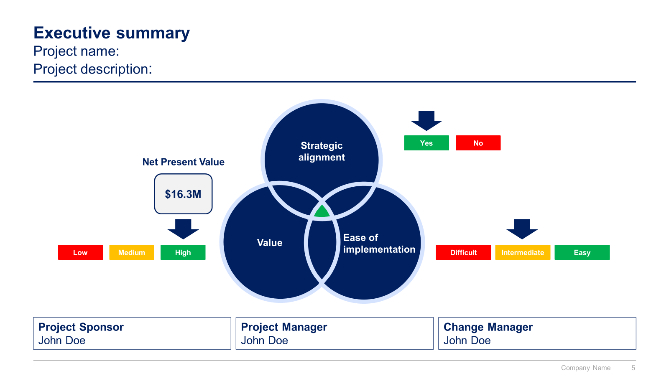
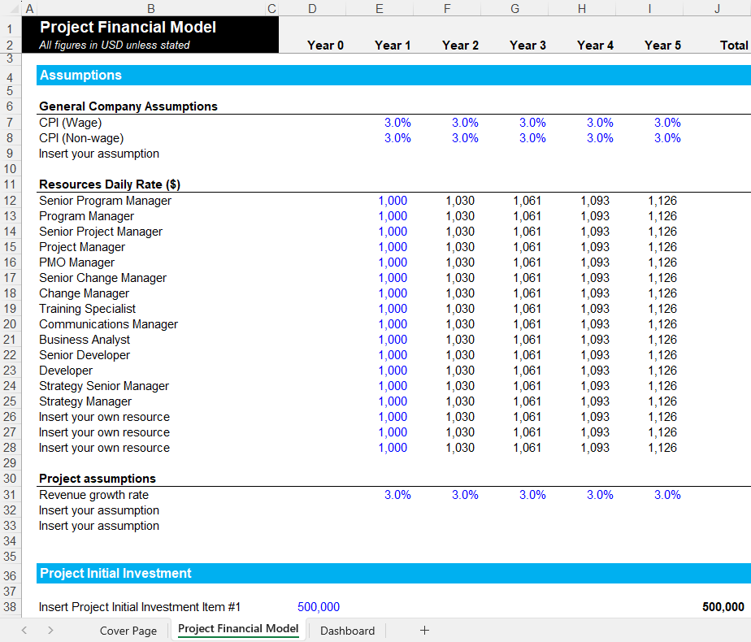
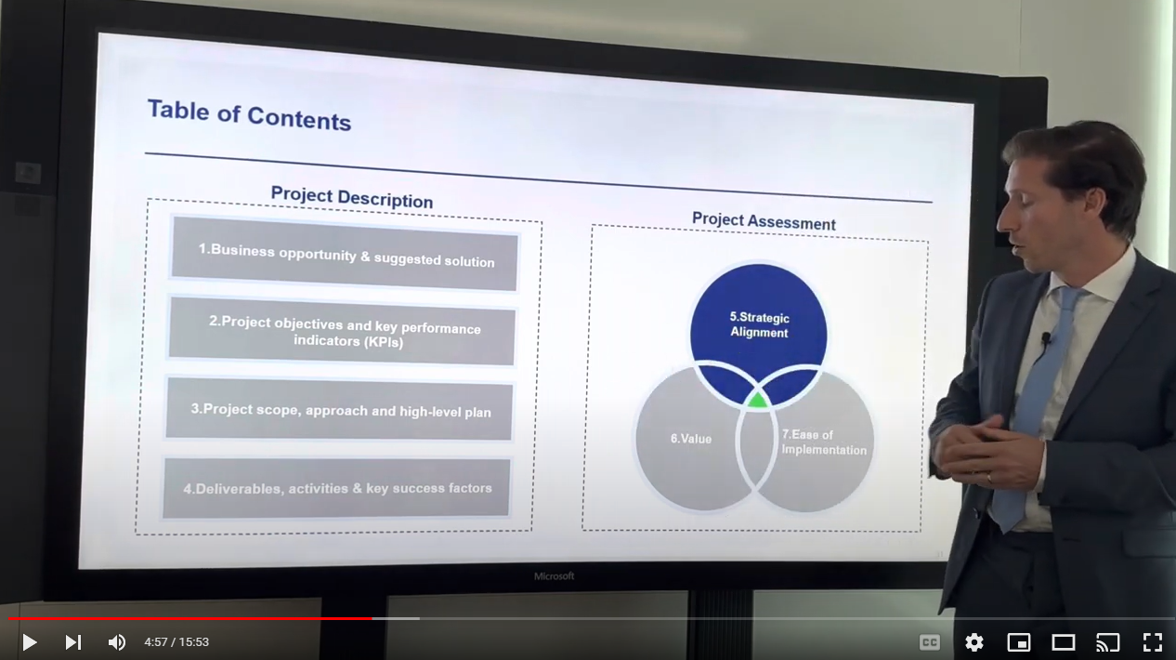
Small preview of the project management traditional approach (2/2)

Slide 14
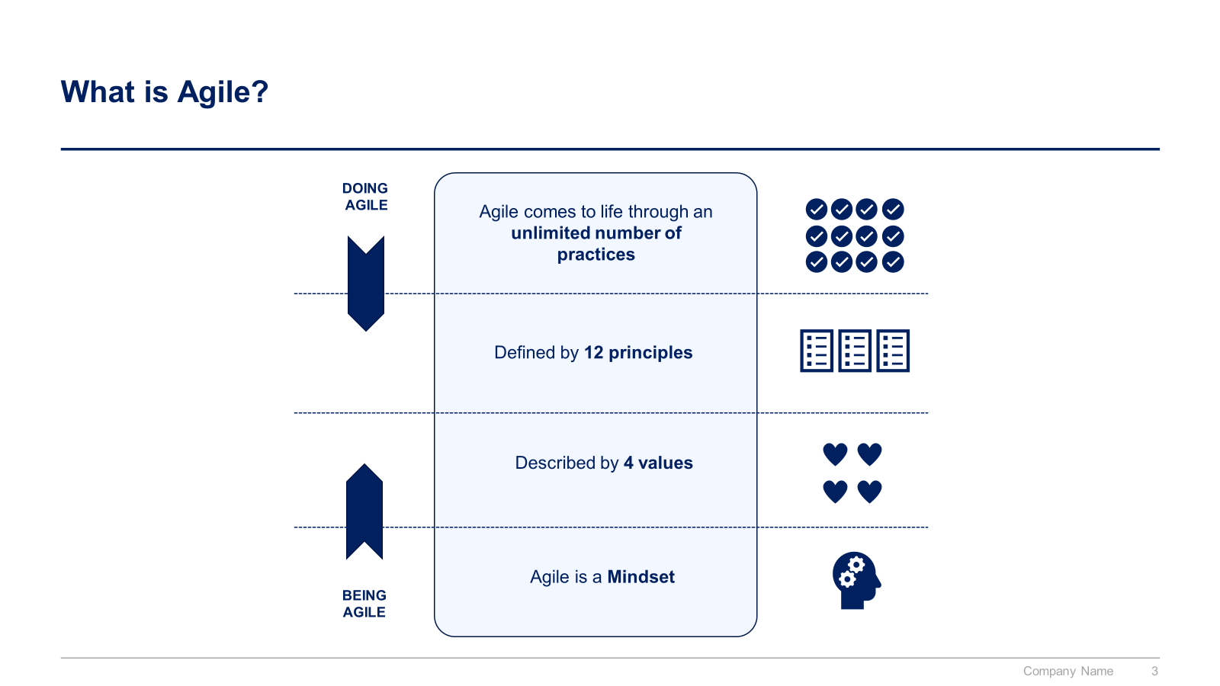
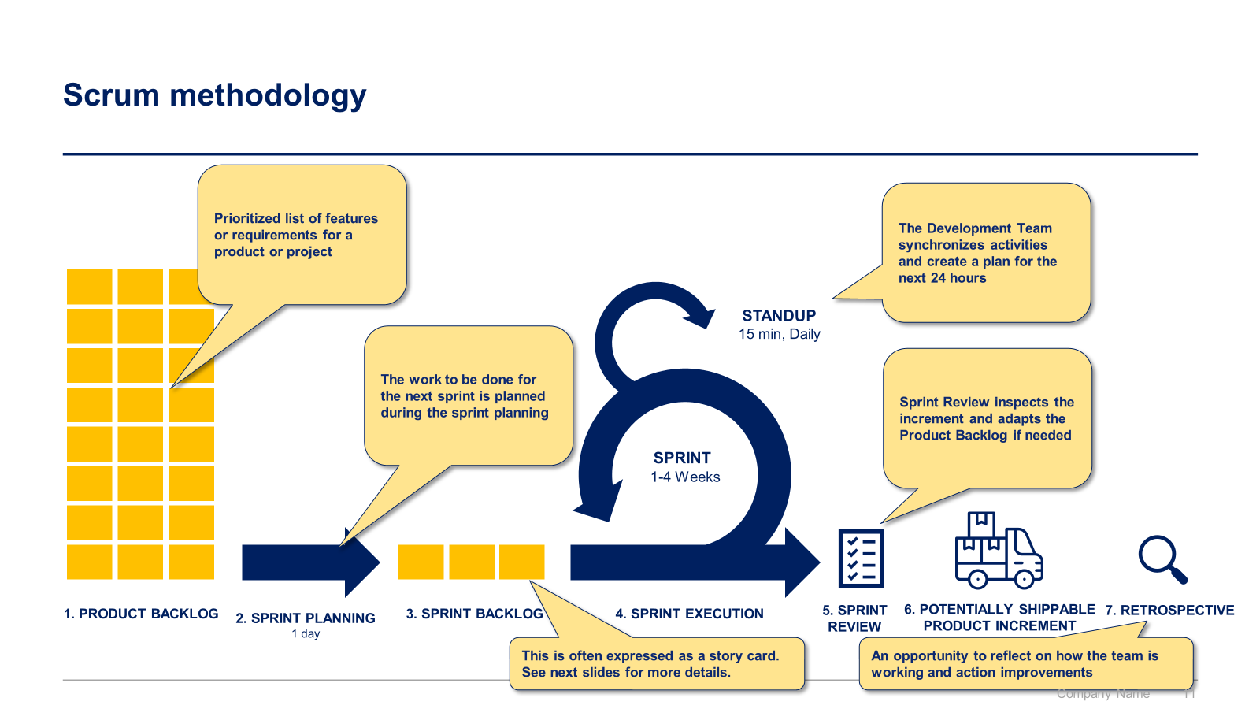
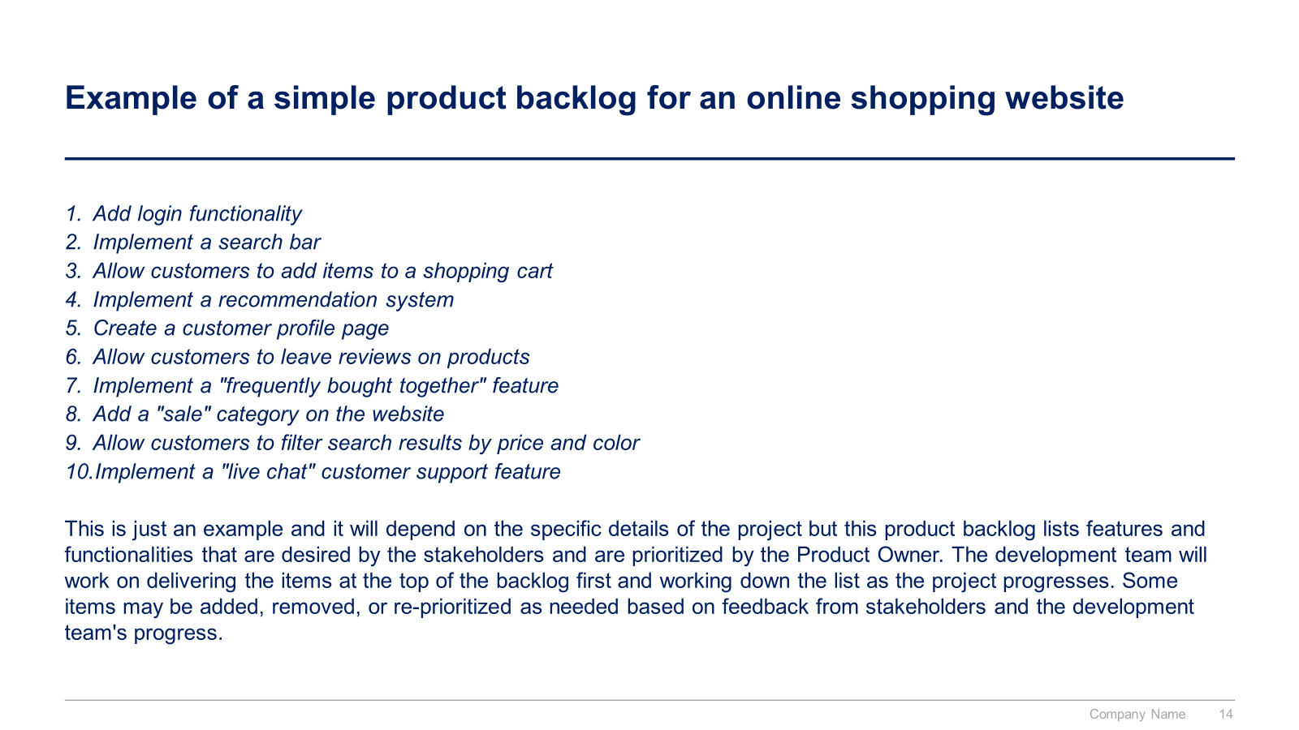
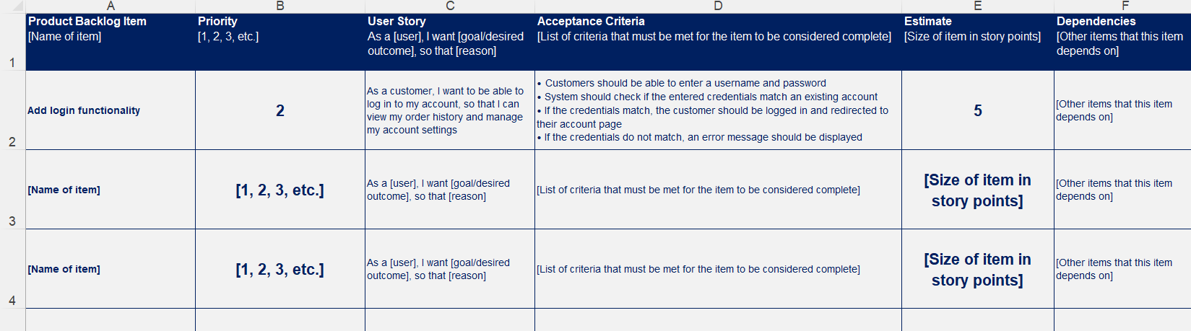
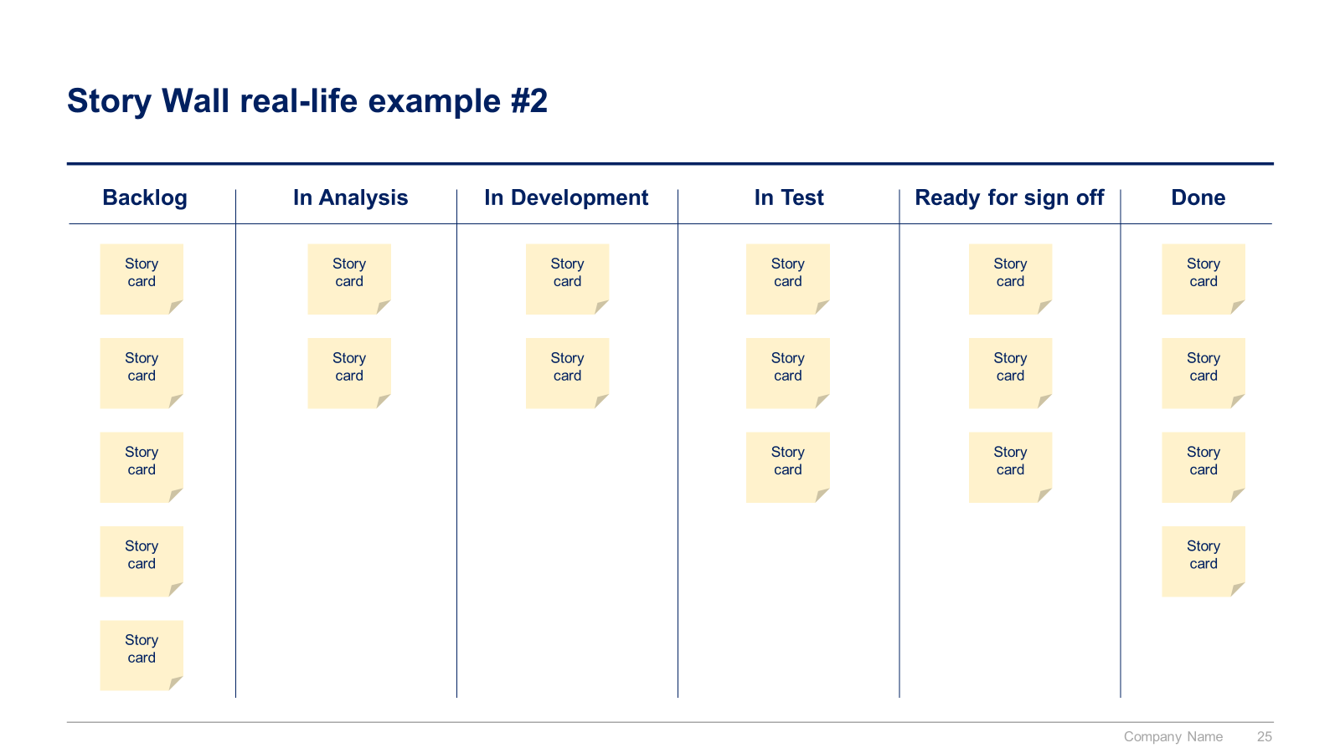
Small preview of the project management Agile approach

Slide 15
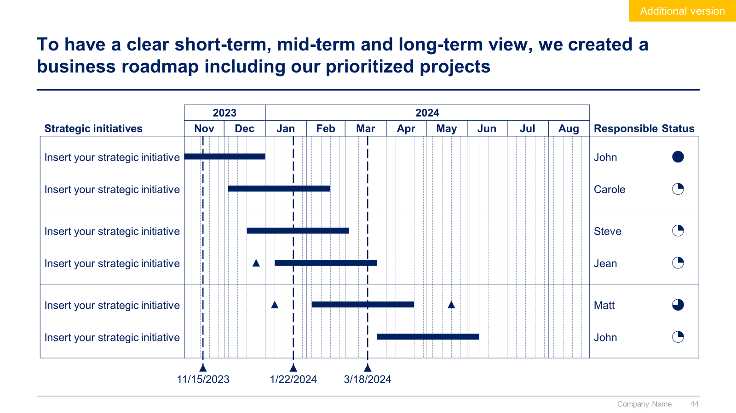
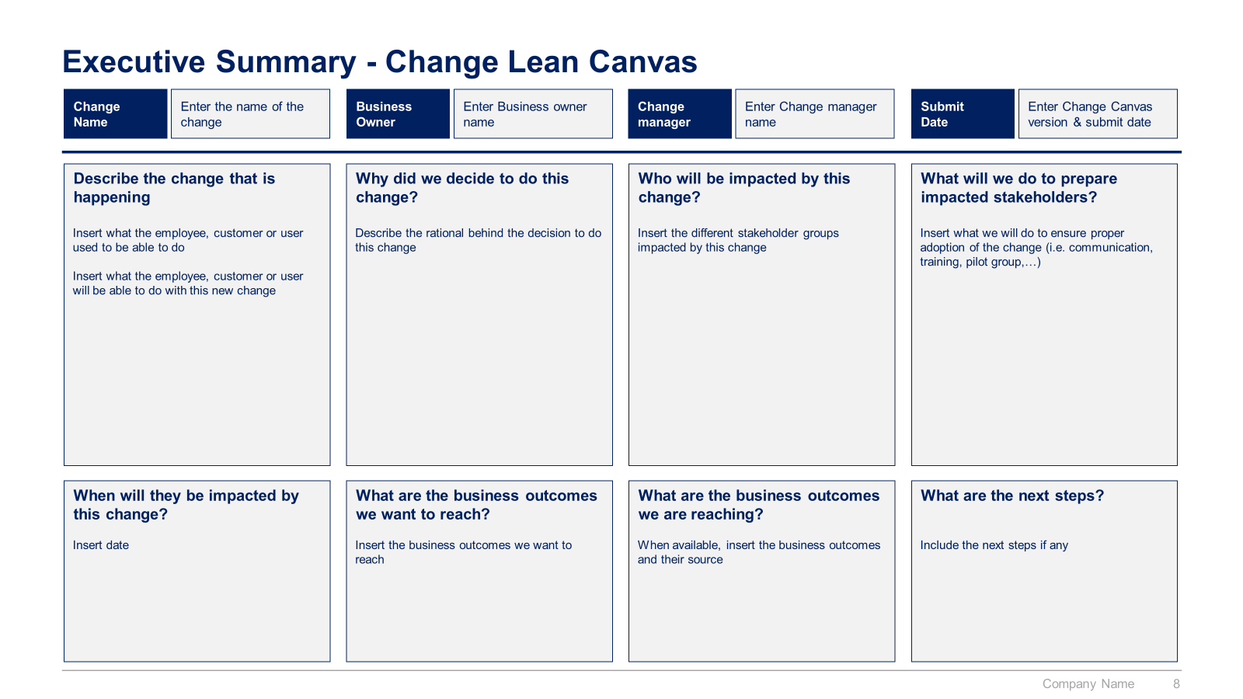
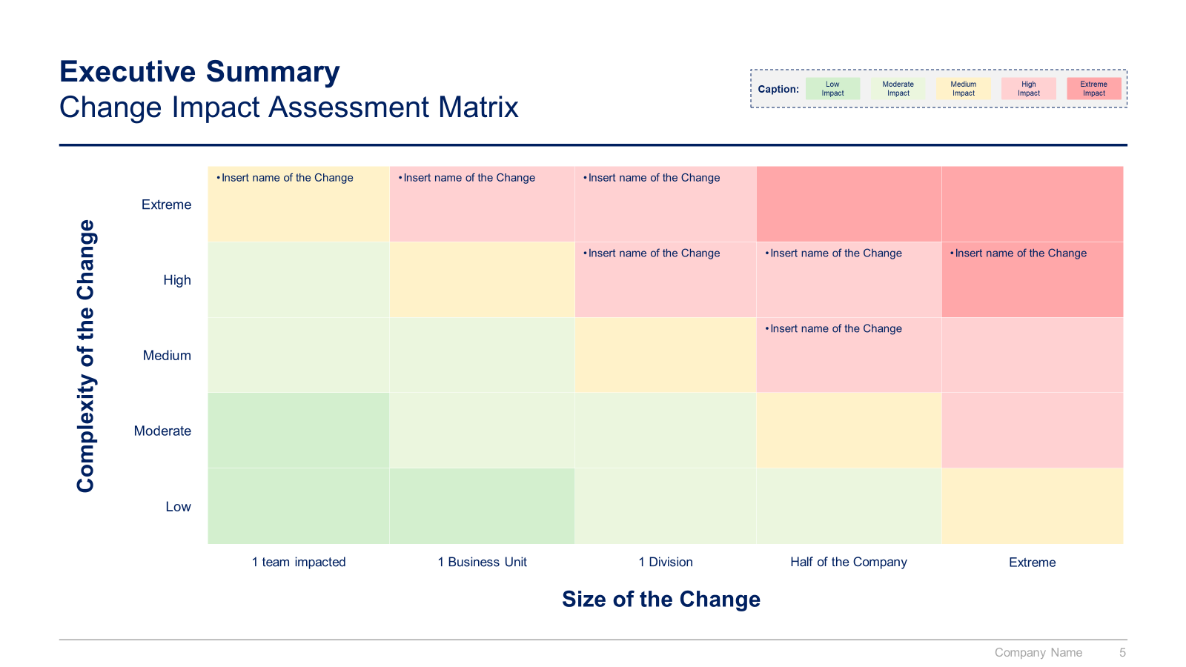
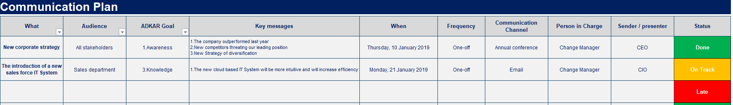
Small preview of the change management approach

Slide 16
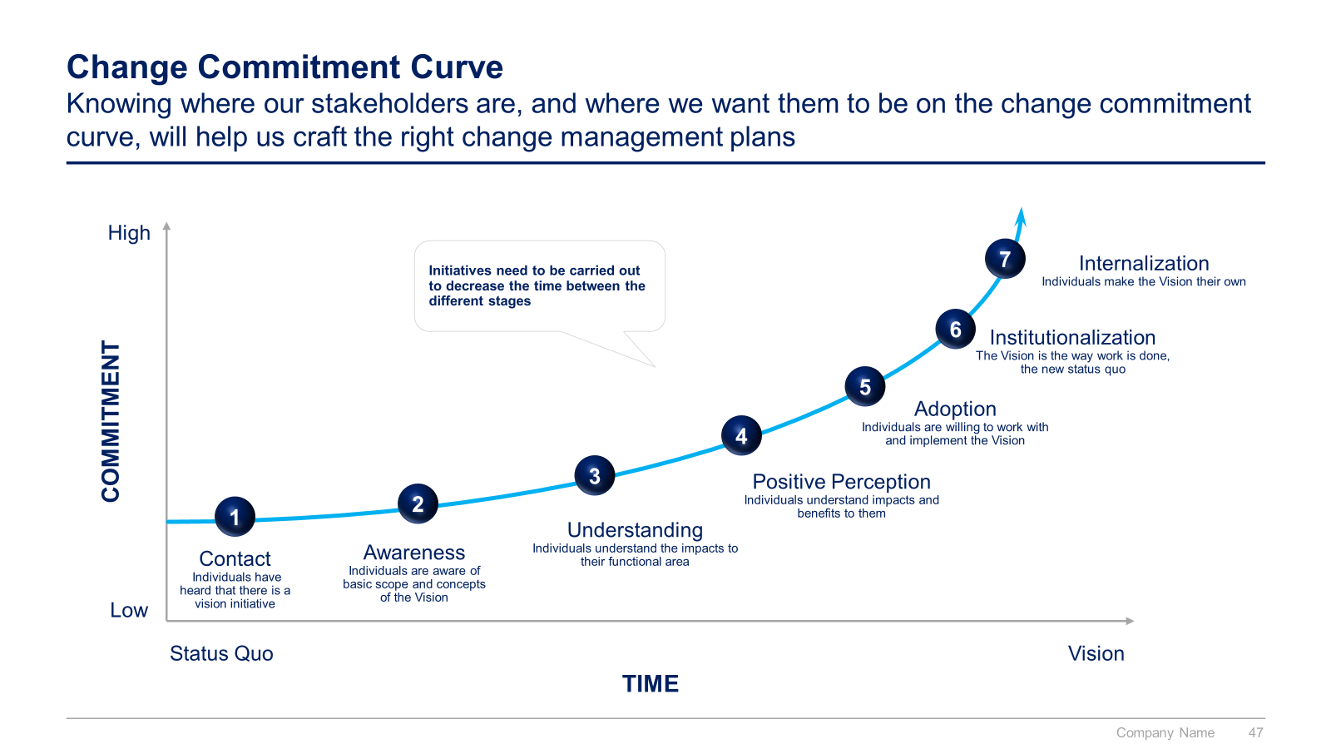
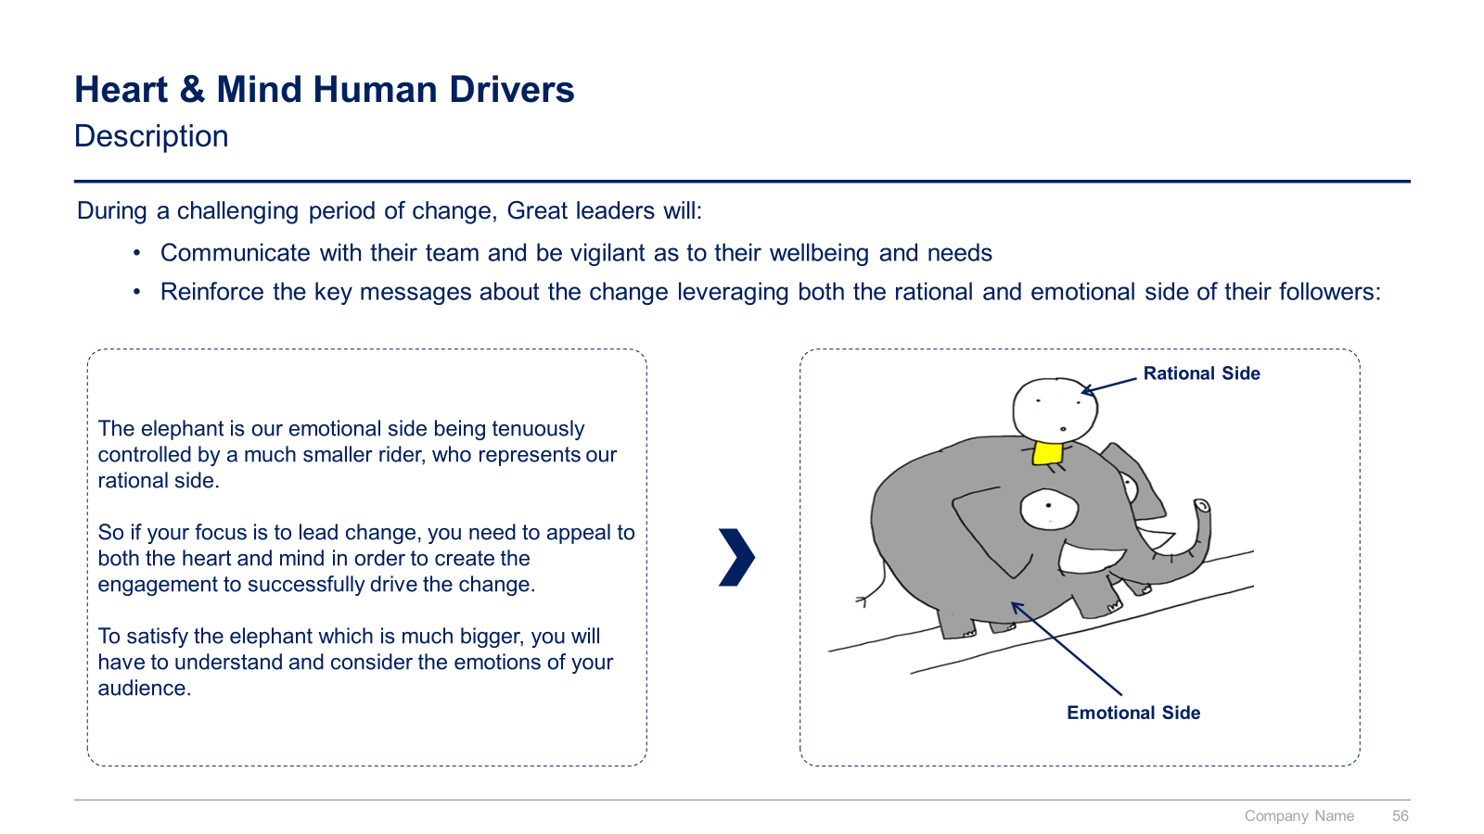
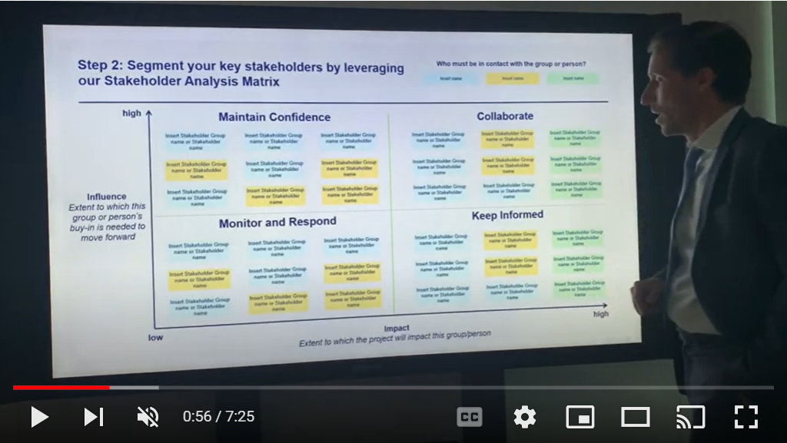
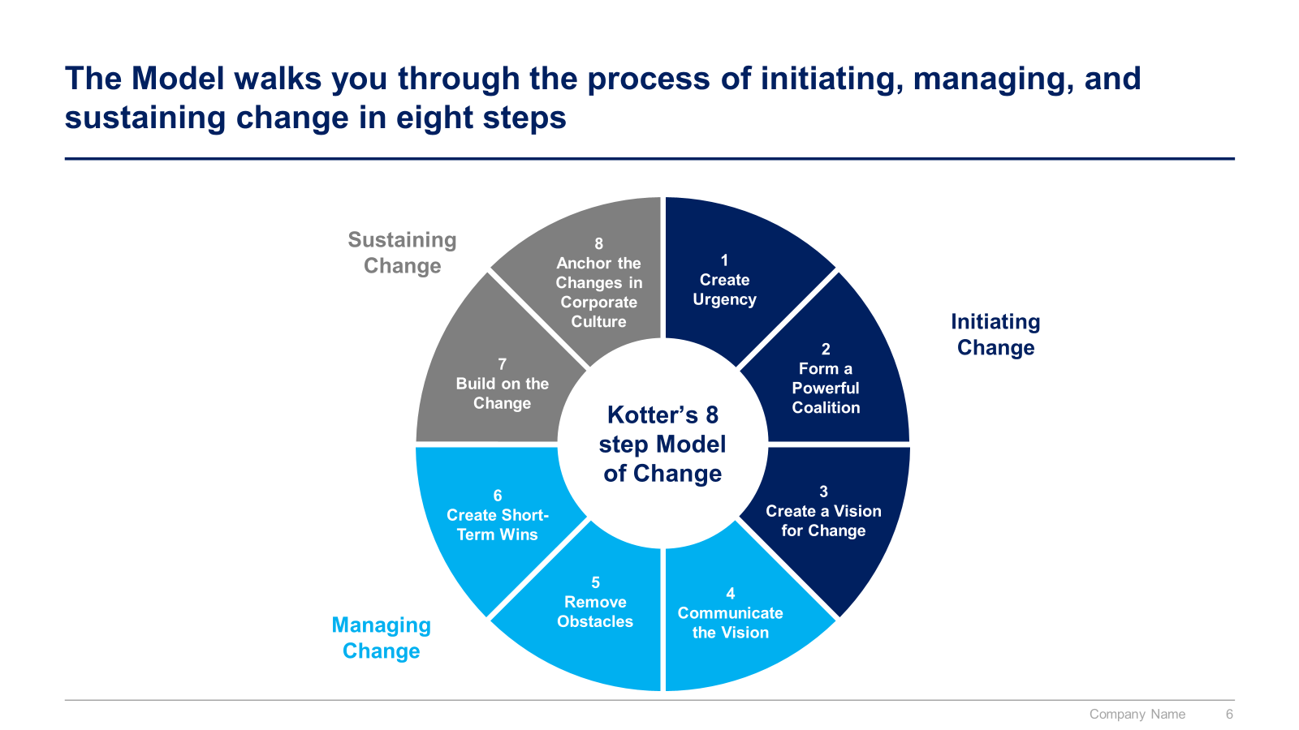
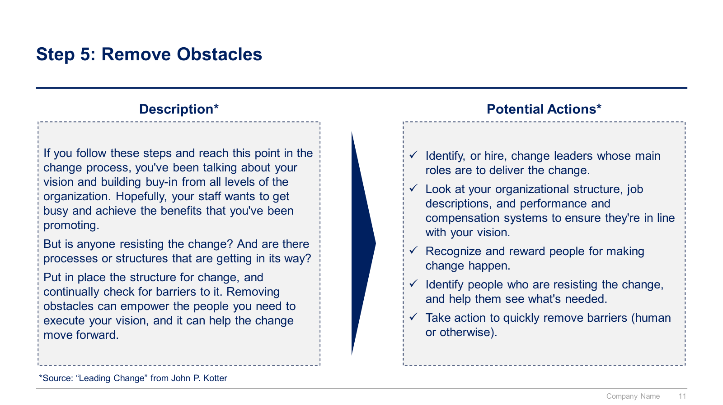
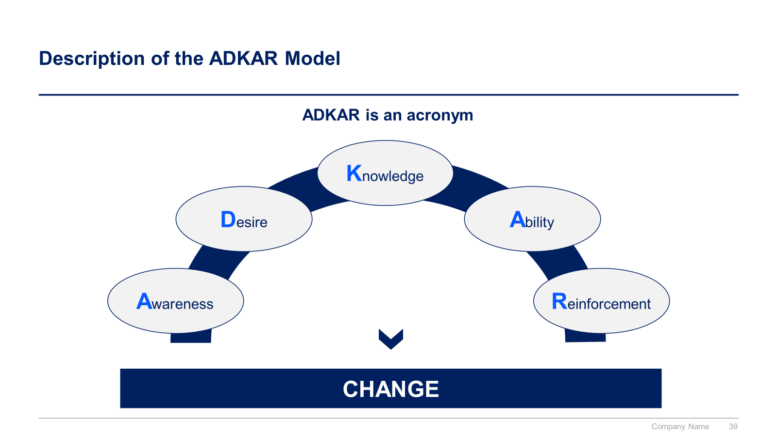
Small preview of the top change management frameworks and tools used by Fortune 100 companies

Slide 17
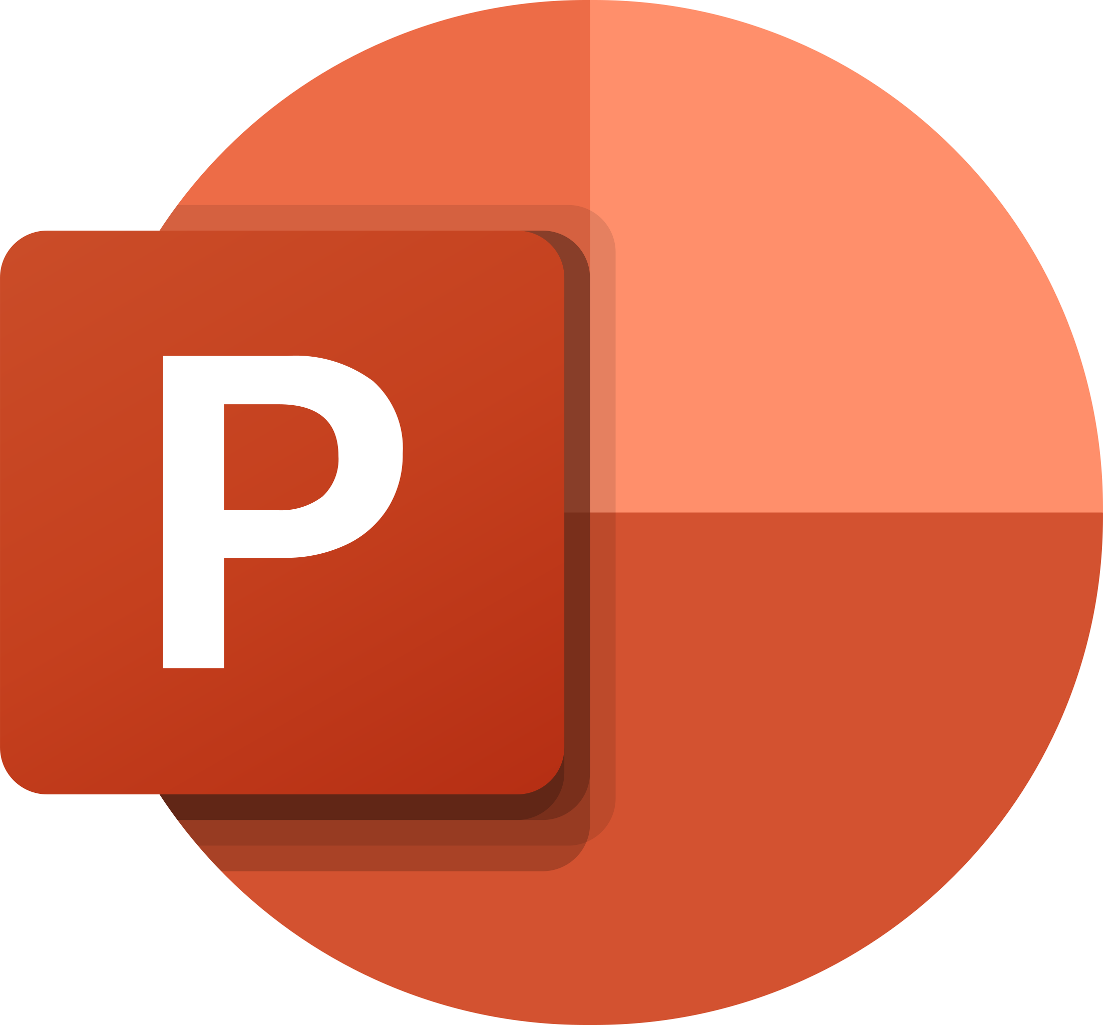
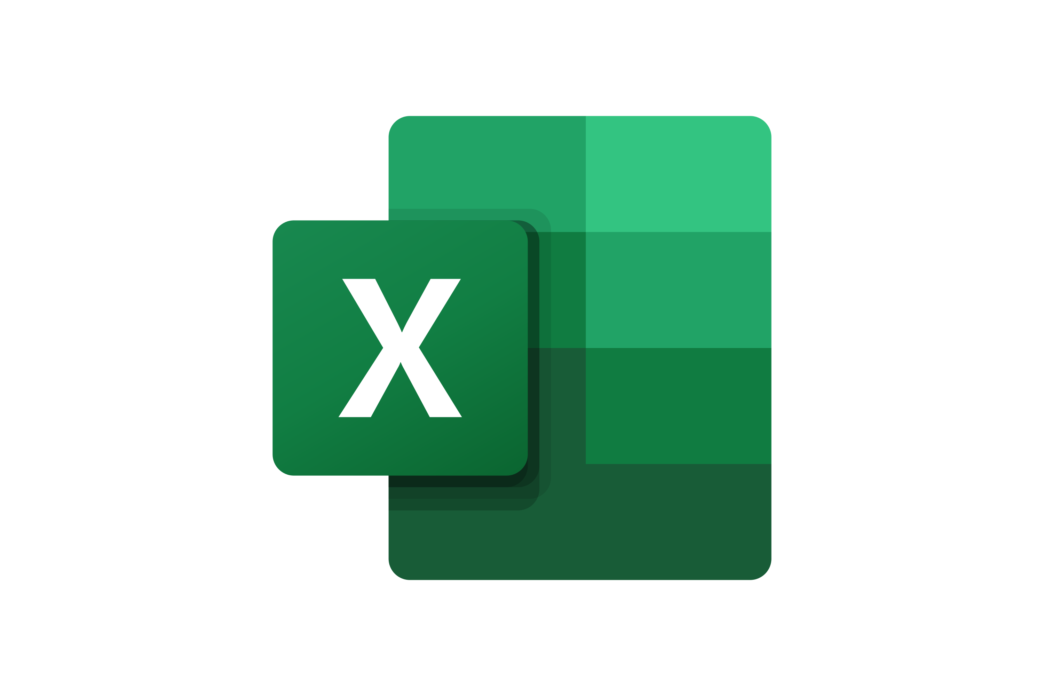

The Toolkit includes multiple PowerPoint slides, Excel sheets and Video training that you can download on your device immediately after purchase
500 editable PowerPoint slides*
21 Excel sheets*
64 minutes of Video training
Overview and Approach
Program Management
Project Management Traditional Approach
Project Management Agile Approach
Change Management
*Please note that the number of Powerpoint slides and Excel sheets listed is the number of unique slides and sheets. For example, a Powerpoint slide that has been duplicated to facilitate our clients’ understanding only counts for one slide

Slide 18









Our Management Consulting Toolkits include 9 key benefits
Improve the growth & efficiency of your organization by leveraging Management Consulting Toolkits created by ex-McKinsey, Deloitte & BCG Consultants.
Make a great investment for your career & organization. It cost us US$8M+ over the past 10 years to create all our Toolkits. Get them for a fraction of this cost.
Get a competitive advantage. It’s like hiring Management Consultants to create all the practical Frameworks, Tools & Templates you need.
Get the job done quicker and never start from scratch again with our ready-made and fully editable Frameworks, Tools & Templates in Powerpoint & Excel.
Don't reinvent the wheel. We have already worked 30,000+ hours over the past 10 years to create all the Management Consulting Toolkits you need.
Improve the capabilities of your organization by learning how the Fortune 100 and Global Consulting Firms do it.
Decrease your costs. Hiring tier-1 Consultants for a project would cost you $300k+. Way more expensive than our Toolkits, which will last you a lifetime!
Become your organization’s subject matter expert and impress your stakeholders with world-class approaches to resolve common business problems.
Get free support and advice from our ex-McKinsey, Deloitte & BCG Management Consultants.

Slide 19
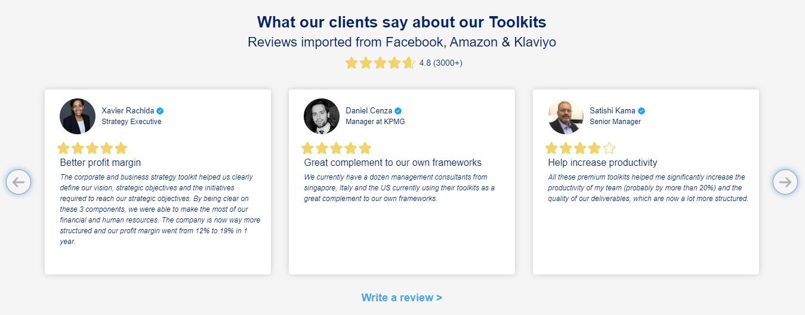
What our clients say about our Toolkits
Click here to see more reviews >

Slide 20

Join 200,000+ Executives, Consultants & Entrepreneurs leveraging our Toolkits to improve the performance of their organization
Trusted by small and large organizations
Customer satisfaction
4.8
Number of countries leveraging our Toolkits
160+
Number of professionals leveraging our Toolkits
200,000+
Daily rate of our ex-McKinsey, Deloitte and BCG Management Consultants
$3k-$4k

Slide 21
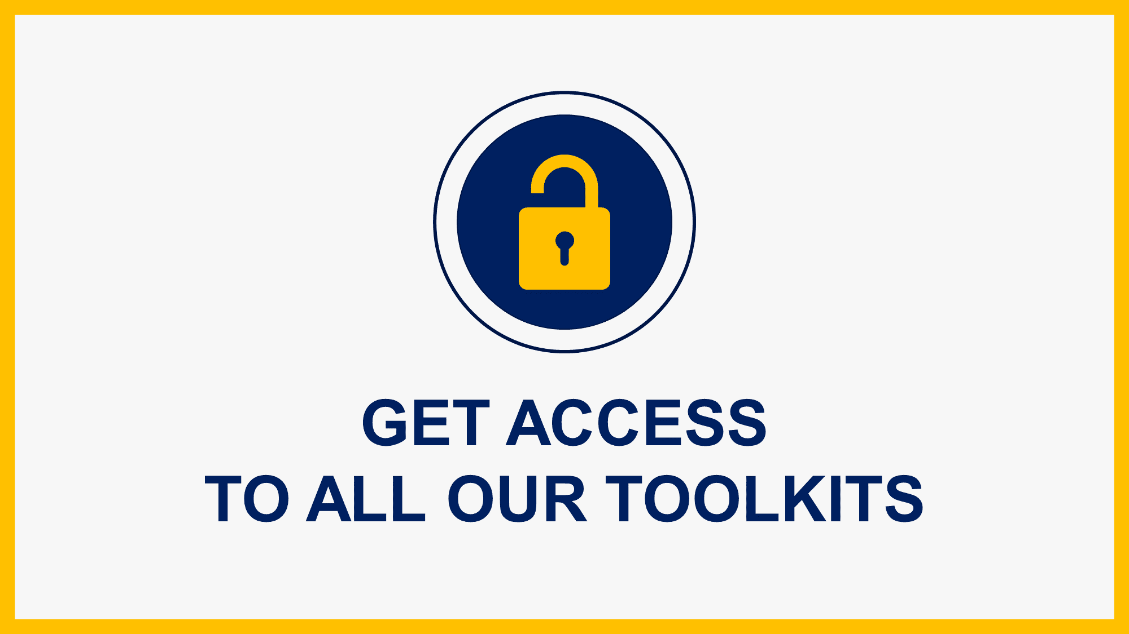
Interested in more than 1 Toolkit? Access all our Toolkits for half the price with our Gold Access
Gold Access
Click here to learn more

Slide 22
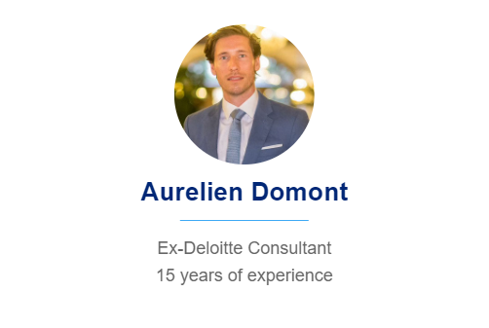
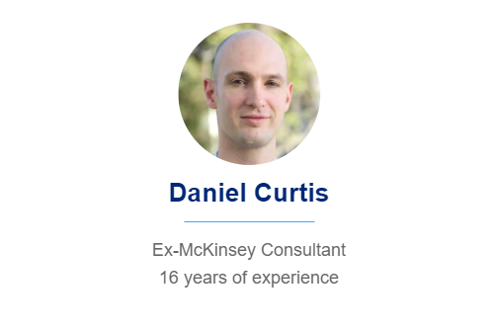
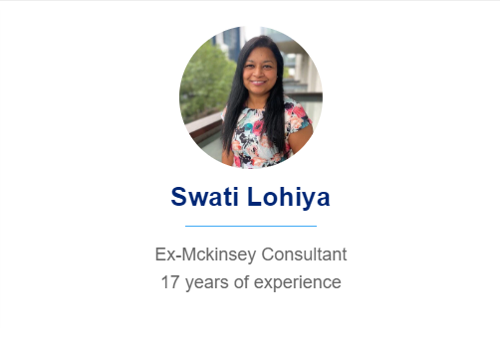
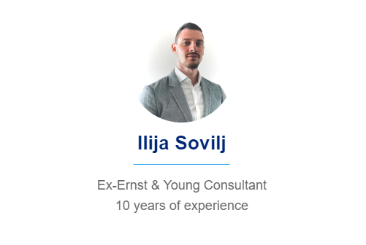
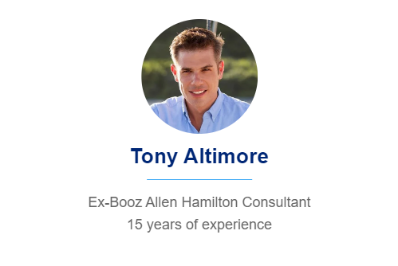
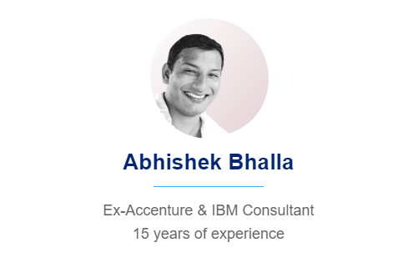
Need additional help? Send us a brief and we’ll find you the right talent from our network of 500+ tier-1 Management Consultants
Click here to send us a Project Brief

Slide 23

This was just a small preview.
www.domontconsulting.com

